Slide 1
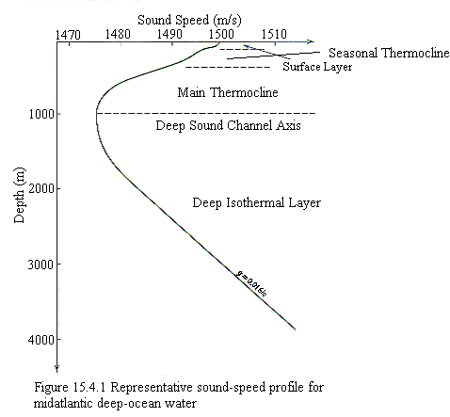
Ocean Thermoclines

