Slide 1
Example Noise Replacement Sentences Diane Kewley-Port 9/30/13
CIN: Consonant Only (noise replaces vowels)
VIN: Vowel only (noise replaces consonants)

Slide 2
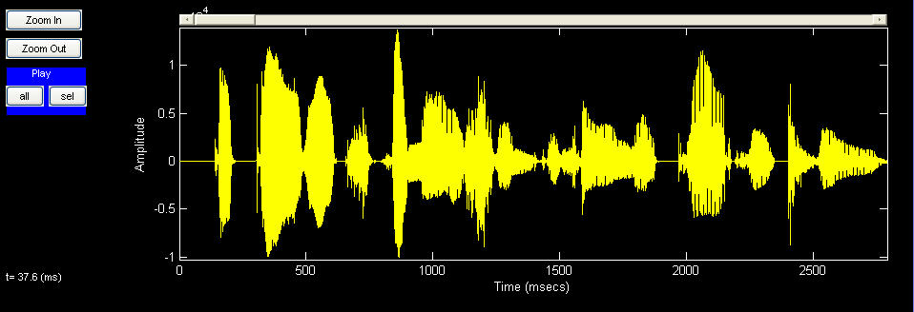
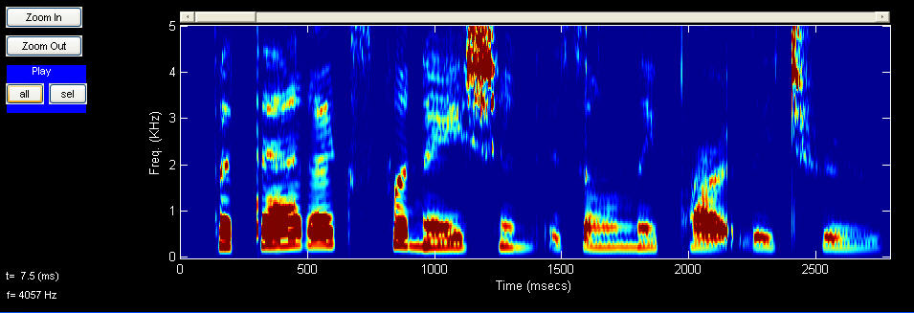
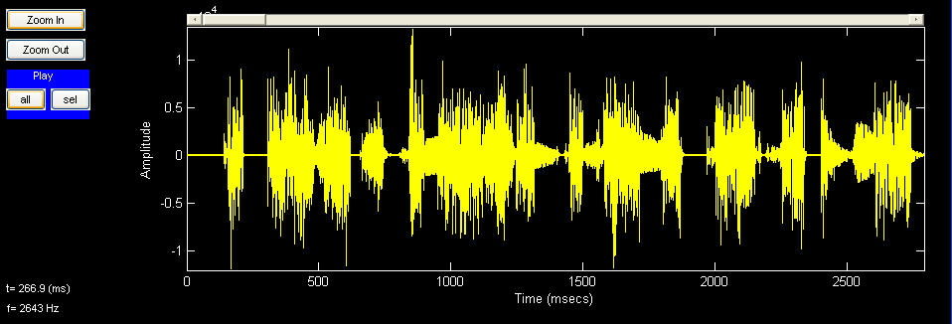
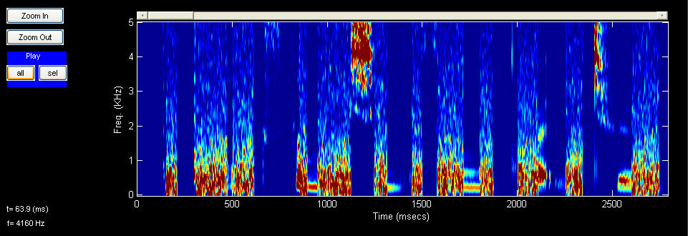
Examples: Full Sentence and Consonants only (CIN)
FULL
CIN
Sentence 601. “But that explanation is only partly true.”
Notes:
Cole used sentences from TIMIT data base where the consonants and vowels were marked by 3 phoneticians.

Slide 3
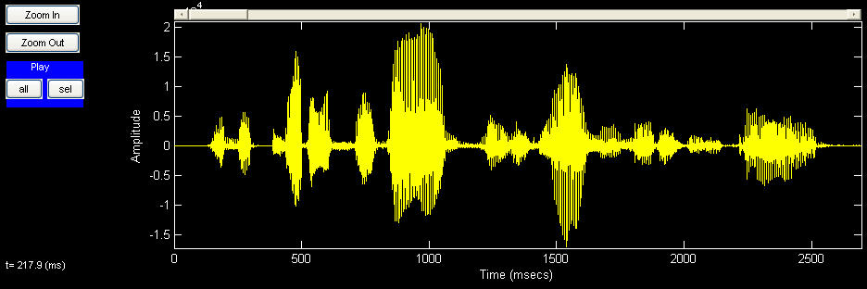
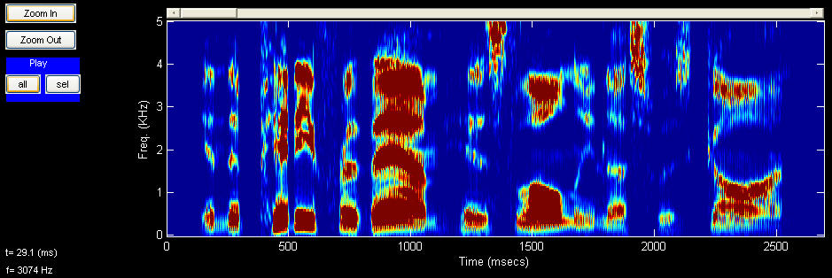
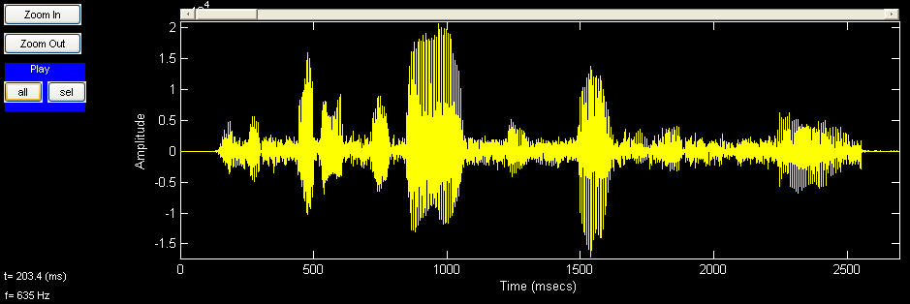
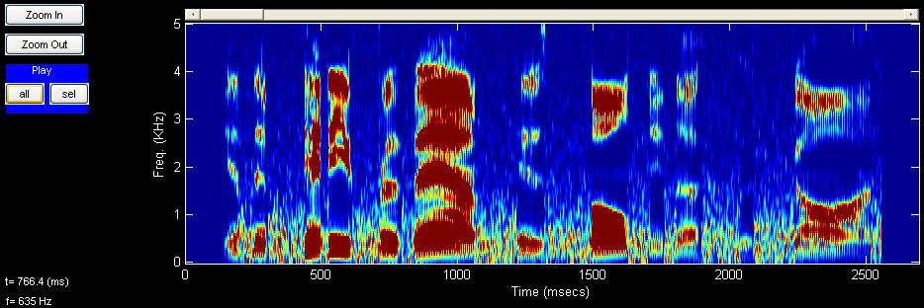
Sentence 1546. “In the pity for them his loneliness was gone.”
Examples: Full sentence and Vowels only (VIN)
FULL
VIN

Slide 4
Example Vin (Vowel only) :
“There was a thick, squashy
crack of fist on flesh.”
Example Cin (Consonant only) :
“But that explanation
is only partly true.”
Notes:
Here are examples of the noise replacement procedure used in our students. Used TIMIT database sentences North Midland dialect. Some low frequency words in sentences. Transcribed by phoneticians who agreed on C/V boundaries.
When vowels preserved, Vin, all consonants replaced with noise (speech shaped). Vice-versa, when consonants preserved, Cin, all vowels replaced with noise. Levels noise matched natural levels of noise in vowels and consonants.

Slide 5
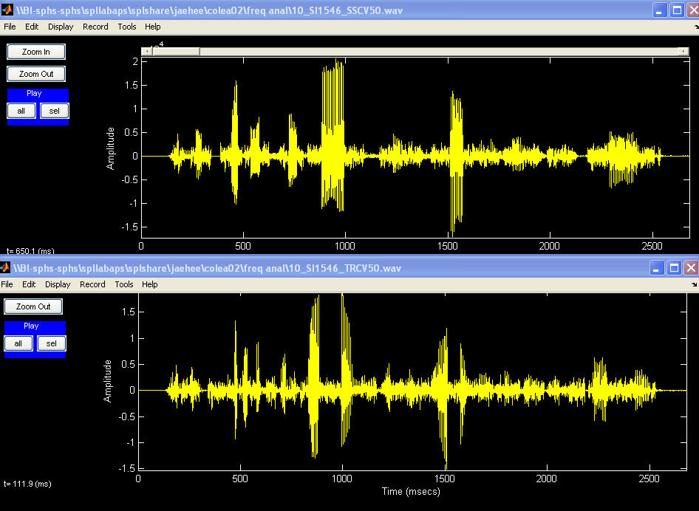
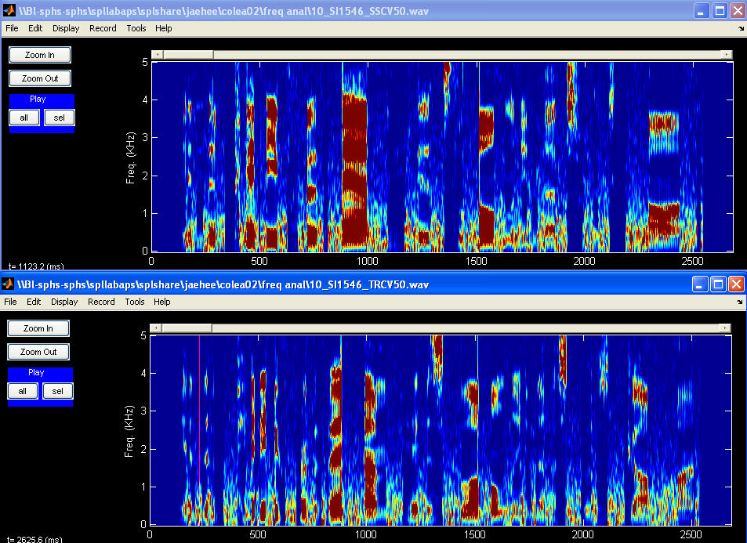
2 conditions: Steady-state (SSVC, i.e. more vowel) and
Transition in vowels and consonants (TRVC, i.e. more consonant)
SSVC
TRVC
FULL
Sentence 1546. In the pity for them his loneliness was gone.
Notes:
Ref)

Slide 6
Random examples Female
Female
S1541
Full
Vin
Si1070
Full
Vin

Slide 7
Random Examples Male
Male
SI1093
Full
Vin
SI905
Full
Cin

